Slide 1

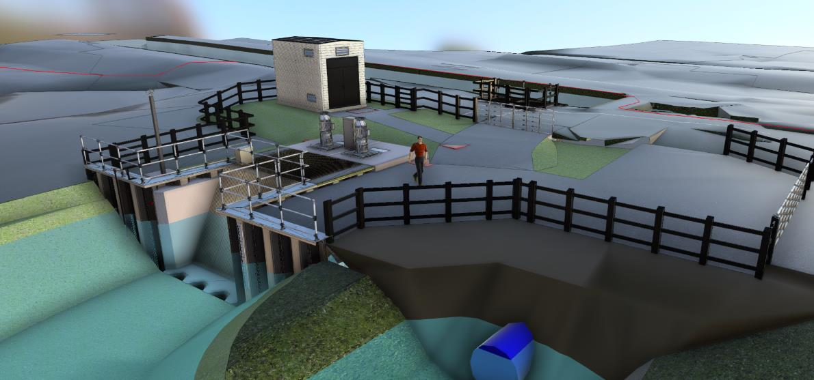


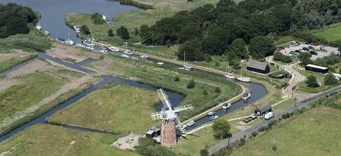
Upper Thurne Integrated Drainage Improvements Project
Potter Heigham Parish Council
23rd April 2025

Slide 2
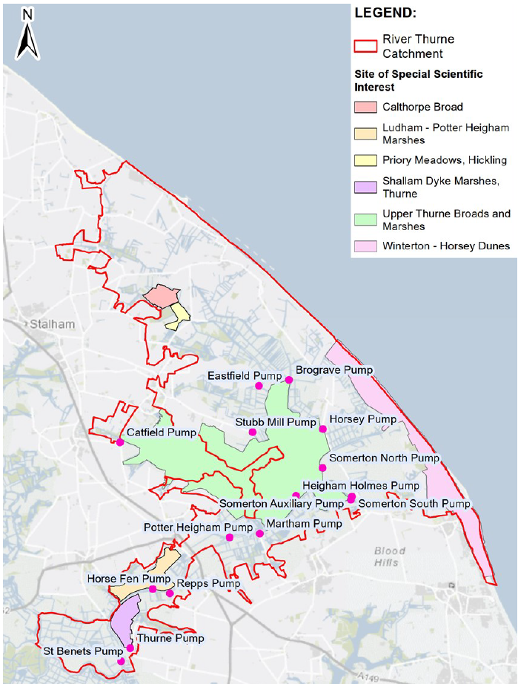
Introduction / project background
Potter Heigham is 1 of 13 stations within the Upper Thurne Integrated Drainage Improvements Project.
Project Assurance received Jan 21. Detailed design for all 13 sites completed April 2025. 11 sites included in current four-year programme from Spring 2025 to Summer 2029.
Package 1 contract awarded in November 2024 (Horsey, St Benets, Martham and Potter Heigham).
Broads Internal Drainage Board - Client
Bam Nuttall Ltd – Principal Contractor
Package 1 Construction commenced Spring 2025. Completion Spring 2026.
Due to funding shortfalls works at Potter Heigham and Martham have paused – planned to recommence Spring 2026.

Slide 3
Project construction costs -
Package 1 (four sites) = c.£16m
Total project value = c.£72m including risk sums.
2. Permissions and consents
Works are being delivered under the BIDB Permissive Powers (Land Drainage Act 1991)
Permitted Development (Certificate of Planned Lawful Use or Development)
Historic England consultation through Environment Statement process
Flood Risk Activity Permit
Natural England Assent
Broads Authority Working Licences obtained by Principal Contractor.
Ground water abstraction Licences obtained by Principal Contractor
Compound Licences with landowners.
Land purchased or leased from landowners.
UKPN Wayleaves for power supply cables
Watervole mitigation undertaken under BIDB Class Licence

Slide 4
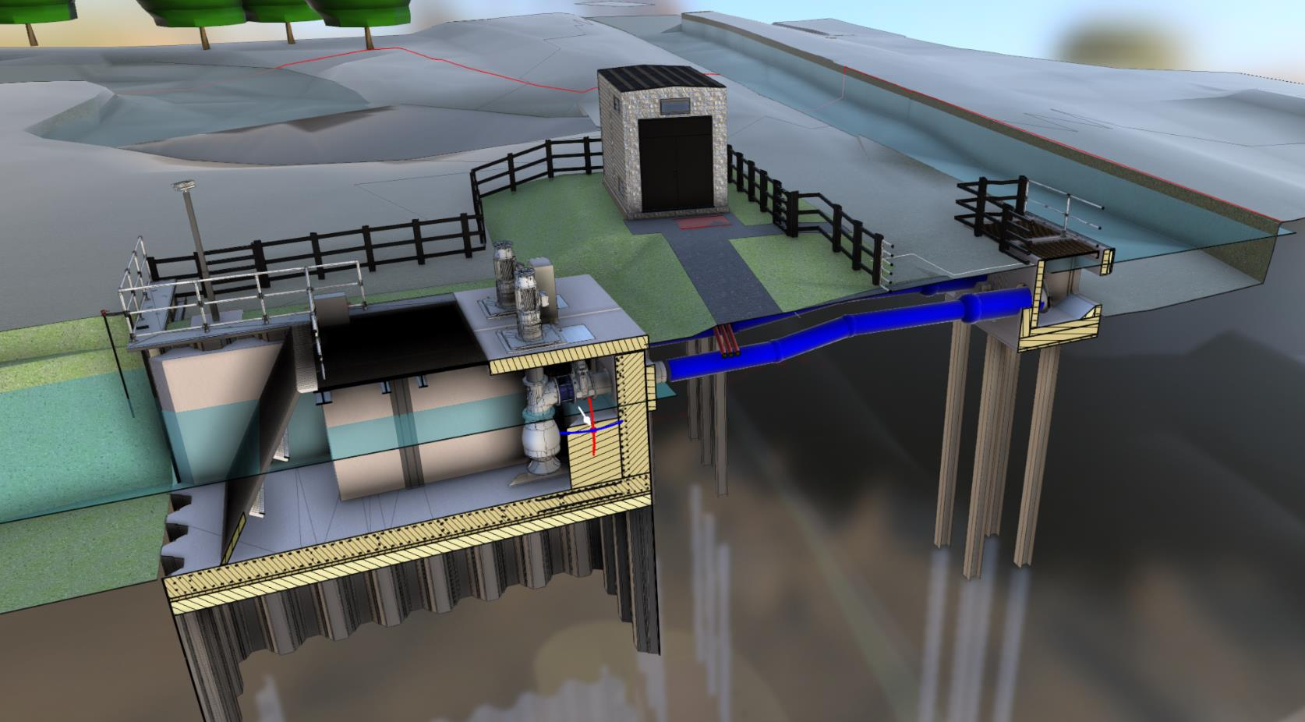
Pump motor
MCC / control building
Intake level sensors
Lightweight flap valves
Energy dissipation chamber
Intake trash screen
Discharge pipework
Outfall structure piles
VDX450 fish friendly pump and secondary non-return valve
Steel sheet piled wet well

Slide 5
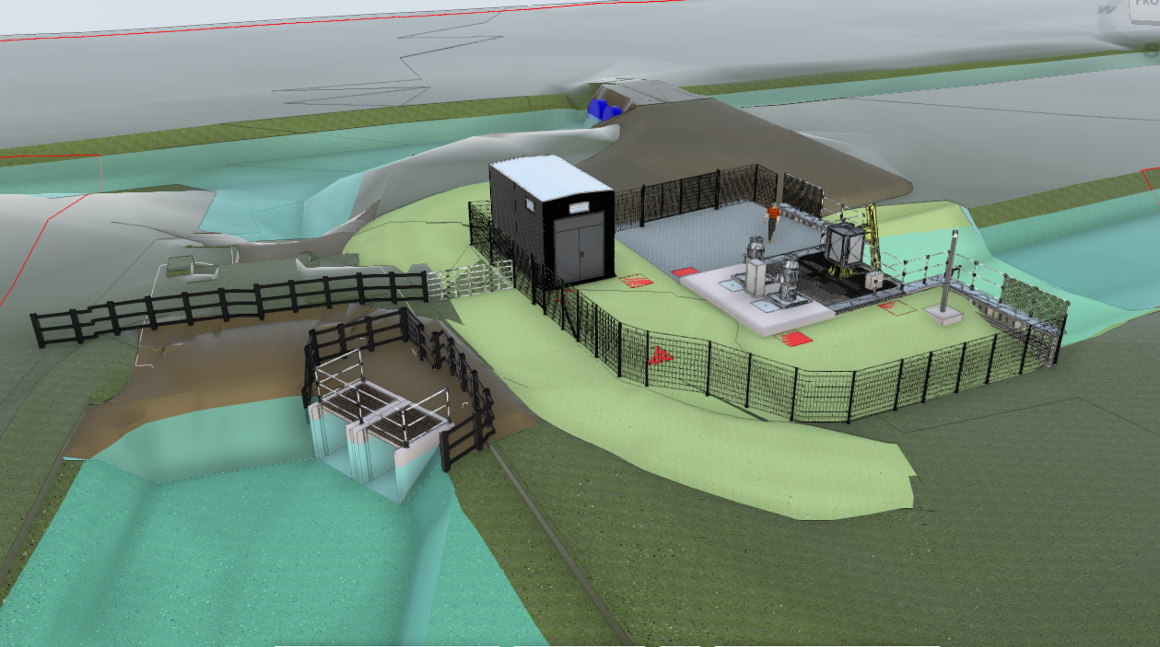

Slide 6
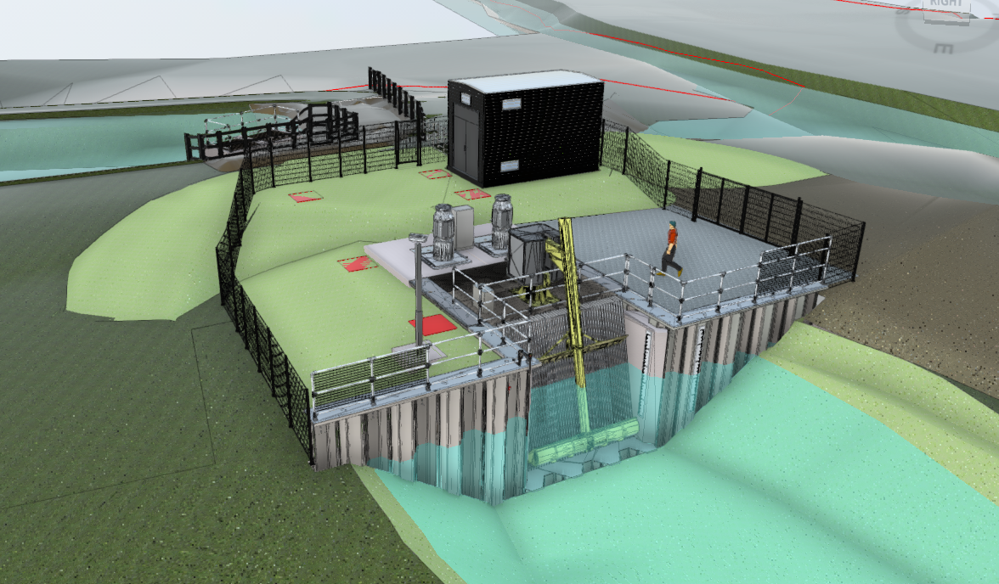

Slide 7
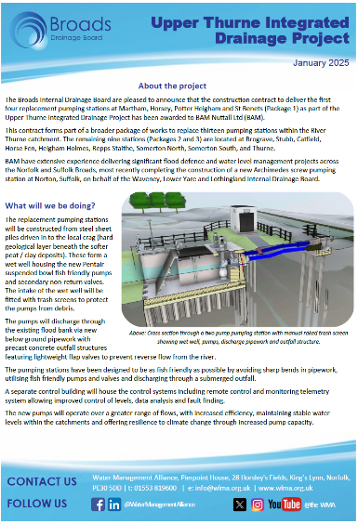
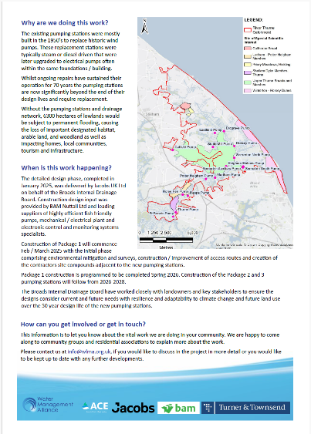
5. Programme
  Winter 2025 – Contract award, pump and trash system orders placed.
  Spring 2025 – Access improvements including upgraded access tracks, culvert construction, site set up and environmental mitigation.
  Summer 2025 – Main civil engineering works, sheet piling, fabrication of pre-cast concrete elements and manufacture of mechanical and electrical equipment including control systems.
  Autumn 2025 – installation of pumps and control systems / commissioning.
  Winter 2025 – Completion of commissioning and demolition / decommissioning of existing stations.
  Spring 2026 – Completion and demobilising. Recommence Potter Heigham and Martham alongside commencement of Brograve Pumping Station.
6. More information
  IDB newsletters - published quarterly (April 2025)
  Information board to be displayed on site with QR code
  NT website – joint comms
  WMA website – https://www.wlma.org.uk/news/

